Slide 1
Injecting hydrogen in the natural gas network: The extent to which hydrogen injection opportunities reduce the required size of a supplementary hydrogen storage
Master’s thesis – Energy logistics
Michiel Tognini
MSc Supply Chain Management

Slide 2
Inhoudsopgave
Introductie
Relevantie
Methodologie
Resultaten
Discussie
Limitaties

Slide 3

Introductie
Locatie wind- en zonne-energie niet overeenkomstig met locatie vraag (Kroniger & Madener, 2014)
Landelijk congestieprobleem
Inperking lokale opwek
Omzetten overschot lokale opwek in waterstof en dit injecteren in gasnetwerk
Aanzienlijke mogelijkheid zonder aanpassingen gasinfrastructuur (Scamman & Newborough, 2016)
Voordelen flexibiliteit energieopwek (Qadrdan, Abeysekera, Chaudry, Wu, & Jenkins, 2015)
Combineren waterstof voor injectie en opslag
Marginale afname in effectiviteit opslag bij toename opslagcapaciteit

Slide 4
To what extent does the option to inject hydrogen into the natural gas network reduce the required size of supplementary hydrogen storage to avoid renewable energy curtailment?
Verschillende injectiescenarios: 0%, 3%, 10% of 20% maximale injectie
Verschillende experimenten:
  Capaciteit opwek
  Maximale uurlijkse export naar hogere spanningsnet
  Wel of niet indirect injecteren vanuit de opslag

Slide 5
Relevantie
Studies met de focus op flexibiliteitsvoordelen waterstofopslag
  Deze impliceren een excessief vereiste opslagcapaciteit (Steinke, Wolfrum & Hoffman, 2013; Heide, Greiner, Von Bremen & Hoffman, 2011; Rodriguez, Becker, Andresen, Heide & Greiner, 2014)
Diversificatie naar andere sectoren energievraag
  Interessante optie power-to-gas → koppelen sectoren stroom, mobiliteit en warmte
  Warmte domineert energievraag → 50% warmte, 20% stroom (IEA, 2015)
  Schaber (2014) → meer economische waarde overtollige opwek door koppeling stroom en warmte
Injectiemogelijkheid tot 20%
  Bovengrens correct functioneren huisdrukregelaars (Kiwa, 2020)
  Aantal studies die voordelen slechts tot 5% injectie hebben gemeten (Simonis & Newborough, 2017; Mukherjee et al., 2015; Qadrdan et al., 2015)

Slide 6
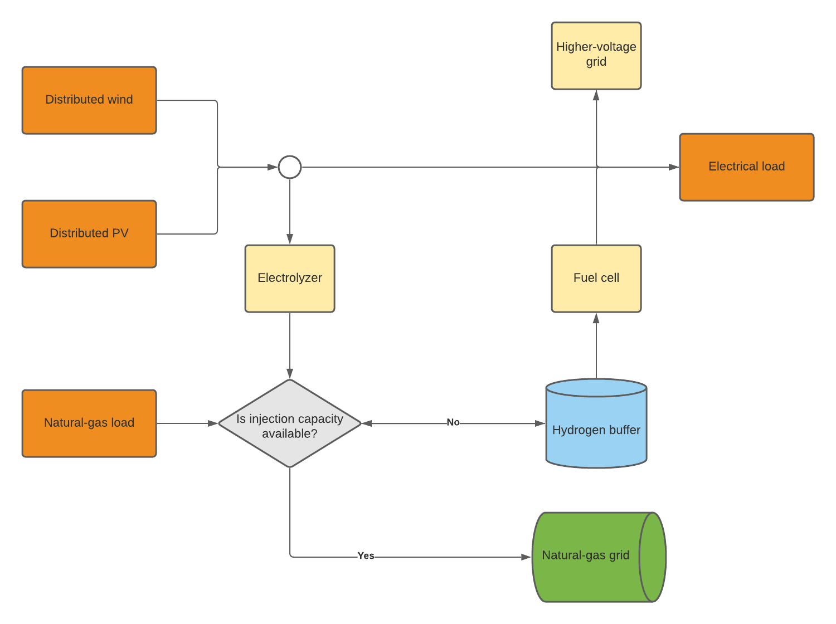
Methodologie
Regionaal energienetwerk
Uurvraag gas (natural-gas load) gemodelleerd voor berekenen maximaal toegestane injectiehoeveelheid per uur
Conversieparameters voor berekeningen tussen
  Kwh stroom
  Kg waterstof
  M3/h gas

Slide 7
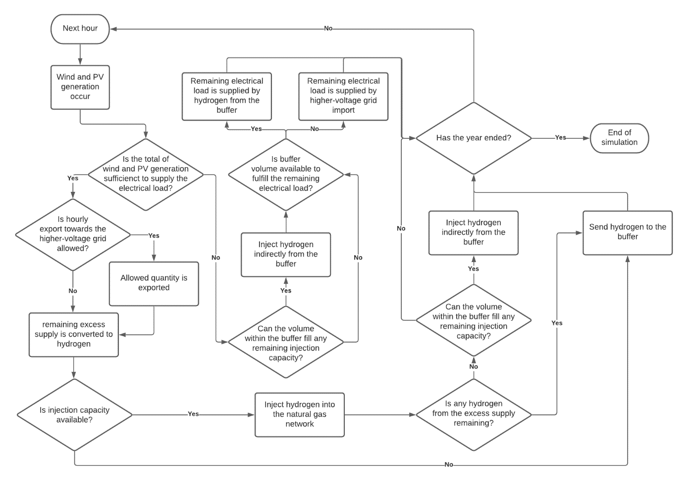

Slide 8
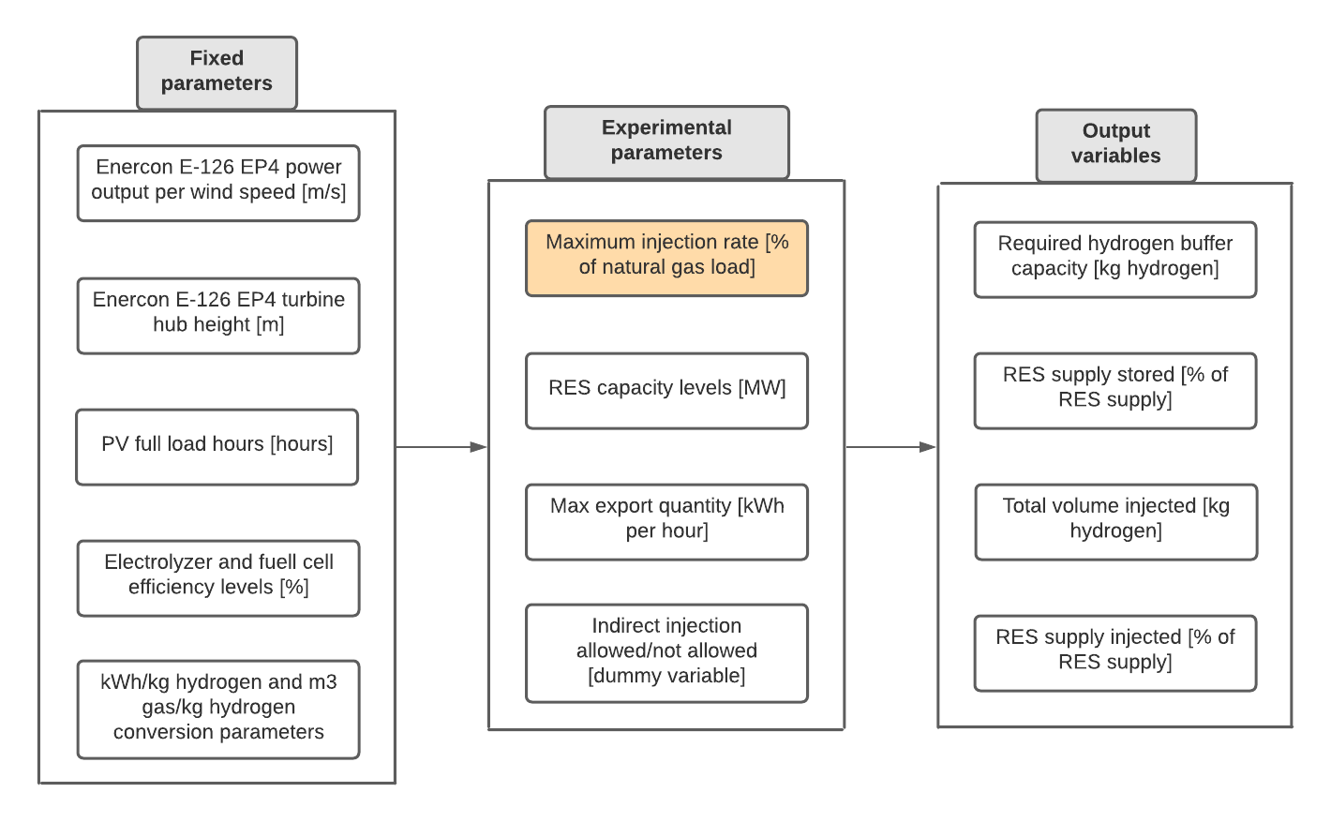

Slide 9

Uitleg gekozen injectiepercentages
3% maximale injectie
Functionaliteit huishoudelijke gastoestellen zonder aanpassingen (Kiwa, 2020)
10% maximale injectie
Bovengrens correct functioneren gashoeveelheidmeters (Altfeld & Pinchbeck, 2013)
Door verandering gaseigenschappen
20% maximale injectie
Bovengrens correct functioneren huisdrukregelaars (Kiwa, 2020)

Slide 10

Output variabelen
Vereiste capacteit waterstofopslag (kg waterstof)
Percentage opwek zon+wind dat de opslag bereikt (%)
Volume waterstof dat geïnjecteerd wordt (kg waterstof)
Percentage opwek zon+wind dat geïnjecteerd wordt (%)

Slide 11
Input model
Opwek wind
Aantal Enercon E-126 EP4 wind turbines
Gemiddelde snelheid wind per uur (m/s)
KNMI Marknesse weerstation
Logarithmic wind profile formule
Opwek zon
Fractie totale globale straling zon (J/m2) per uurvak
Vraag stroom
Totale standaardjaarvraag consumptie stroom
E1C verbruiksprofielen (NEDU, 2021)
Vollasturen zon
KNMI Marknesse weerstation
Capaciteit zon

Slide 12
Experimentele opstelling
Experiment number: | 1-4 | 5-20 | 21-28 | 29-32
Scenario group name | Injection capacity scenarios | RES generation scenarios | Max export scenarios | Indirect injection scenarios
Injection rate [% of hourly natural gas load] | 0% - 20% | 0% - 20% | 0% - 20% | 0% - 20%
Wind generation capacity [MW] | 4.2 MW | 4.2 MW - 12.6 MW | 4.2 MW | 4.2 MW
PV generation capacity [MW] | 4.2 MW | 4.2 MW - 12.6 MW | 4.2 MW | 4.2 MW
Maximum hourly export quantity [kWh] | 0 kWh | 0 kWh | 250 kWh & 500 kWh | 0 kWh
Indirect injection allowed [Yes/No] | Yes | Yes | Yes | No

Slide 13
Resultaten
Analyse 1 - output per categorie experimenten
Experimenten zon- en windopwek
Experimenten export hogere spanningsnetwerk
Experimenten optie indirect injecteren
Analyse 2 - sensitiviteitsanalyse vereiste opslagcapaciteit

Slide 14
Experimenten zon- en windopwek
Experiment | Required hydrogen buffer capacity [kg] | RES supply stored | Total volume injected [kg] | RES supply injected
Base case | 1,149 | 16.81% | 13,180 | 5.58%
8.4 MW wind & 4.2 MW PV | 7,597 | 33.59% | 30,714 | 7.63%
12.6 MW wind & 4.2 MW PV | 32,821 | 46.24% | 43,358 | 7.62%
4.2 MW wind & 8.4 MW PV | 2,413 | 29.19% | 17,366 | 5.67%
4.2 MW wind & 12.6 MW PV | 4,060 | 38.94% | 20,776 | 5.53%
Experiment | Required hydrogen buffer capacity [kg] | RES supply stored | Total volume injected [kg] | RES supply injected
Base case | 503 | 7.60% | 36,535 | 15.46%
8.4 MW wind & 4.2 MW PV | 3,789 | 17.20% | 111,041 | 27.57%
12.6 MW wind & 4.2 MW PV | 8,411 | 28.11% | 187,750 | 32.99%
4.2 MW wind & 8.4 MW PV | 1,046 | 18.15% | 58,259 | 19.03%
4.2 MW wind & 12.6 MW PV | 2,252 | 27.50% | 75,592 | 20.11%
Resultaten 3% maximale injectie
Resultaten 20% maximale injectie

Slide 15
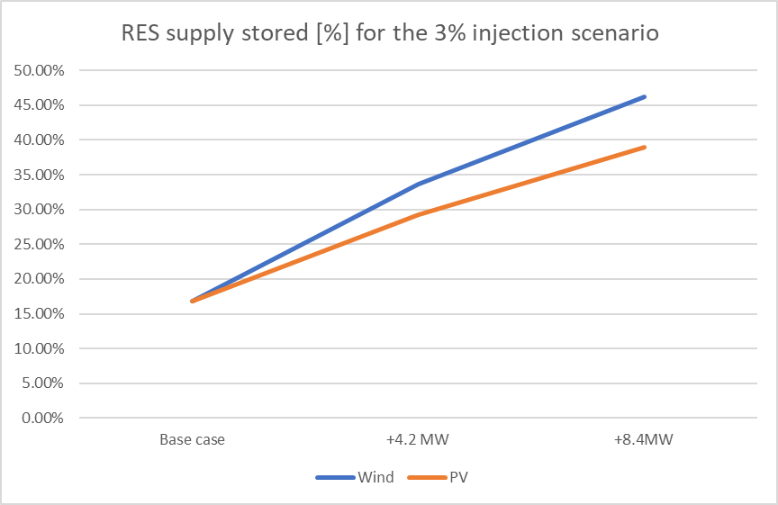
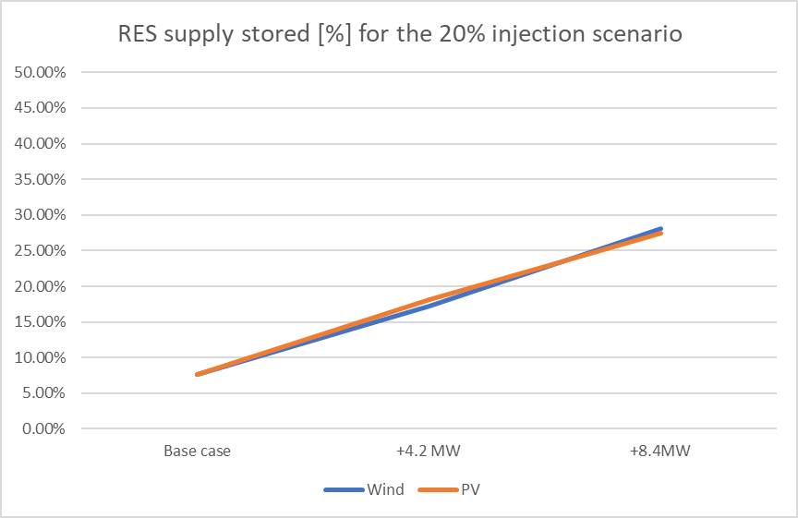
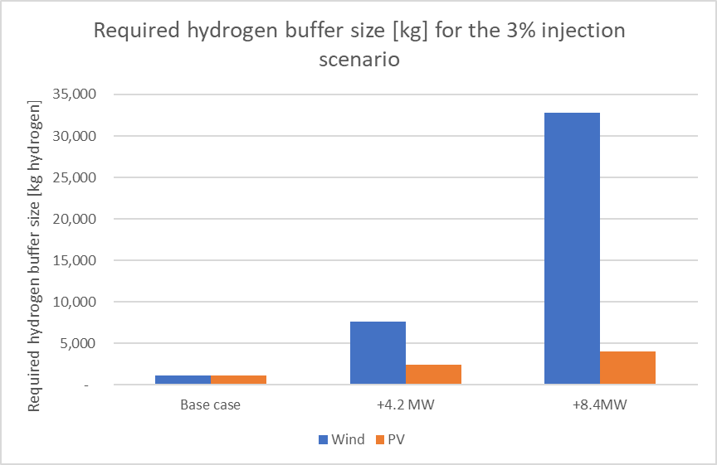
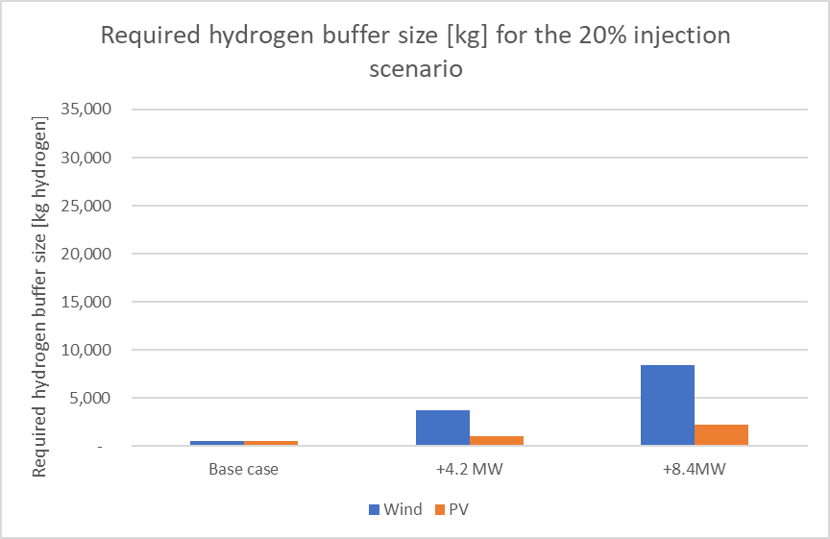

Slide 16
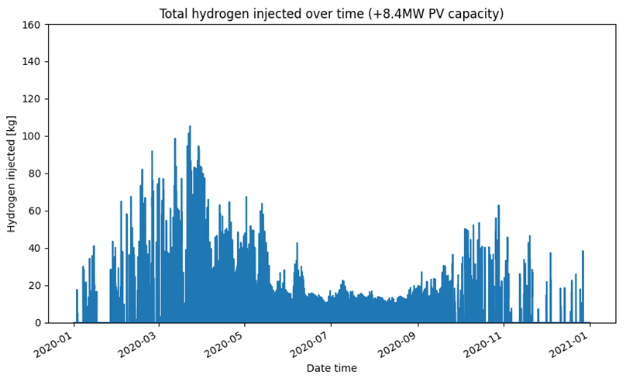
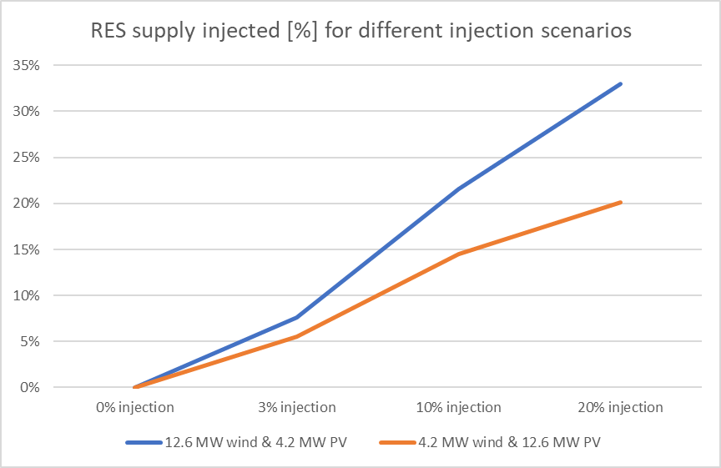
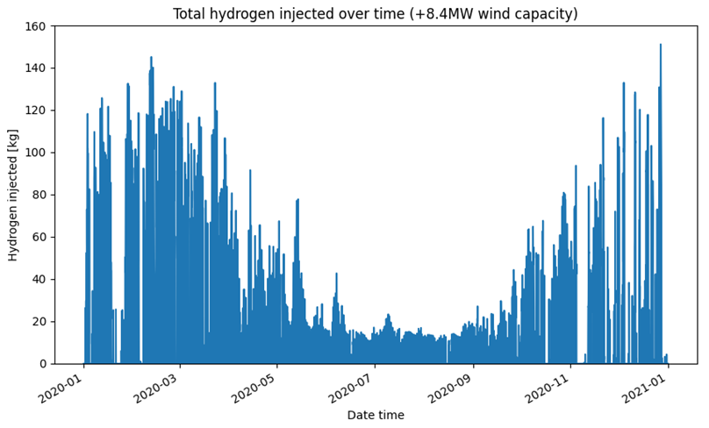

Slide 17
Experimenten export hogere spanningsnetwerk
Experiment | Required hydrogen buffer capacity [kg] | RES supply stored | Total volume injected [kg] | RES supply injected
Base case | 1,149 | 16.81% | 13,180 | 5.58%
250 kWh hourly allowed export | 983 | 13.89% | 11,826 | 5.01%
500 kWh hourly allowed export | 817 | 11.31% | 10,296 | 4.36%
Experiment | Required hydrogen buffer capacity [kg] | RES supply stored | Total volume injected [kg] | RES supply injected
Base case | 503 | 7.60% | 36,535 | 15.46%
250 kWh hourly allowed export | 468 | 6.18% | 31,032 | 13.13%
500 kWh hourly allowed export | 433 | 4.99% | 26,081 | 11.04%
Resultaten 3% maximale injectie
Resultaten 20% maximale injectie

Slide 19
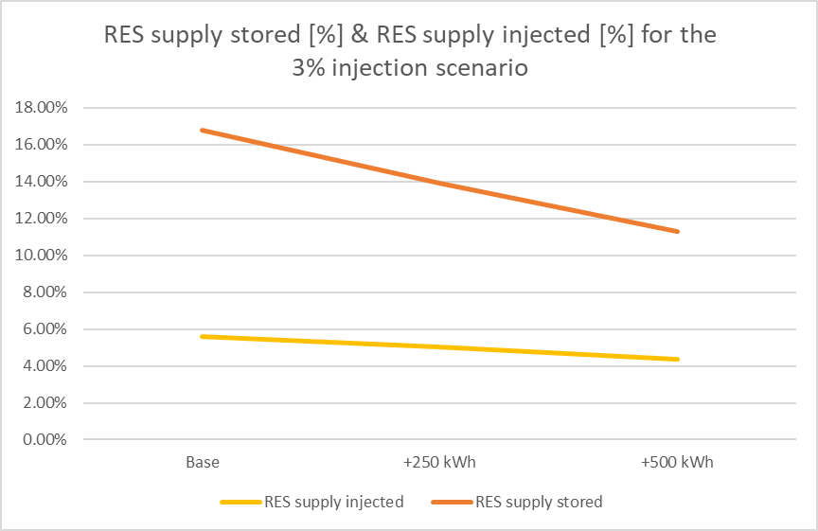
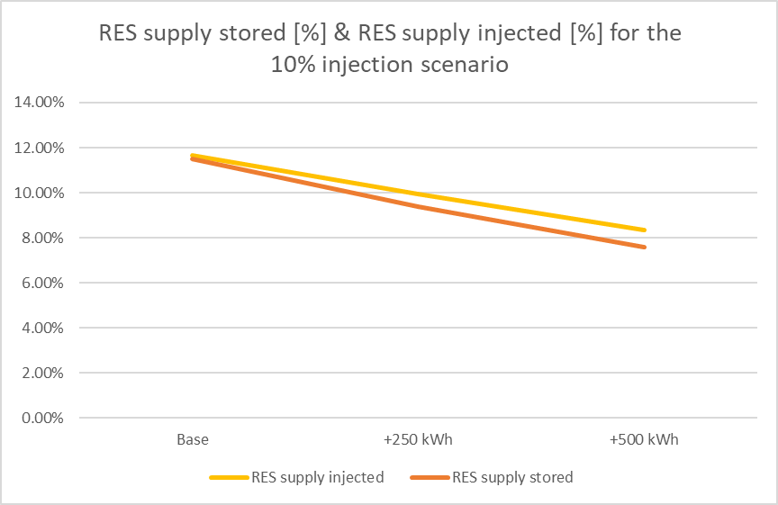

Slide 21
Experimenten optie indirect injecteren
Experiment | Required hydrogen buffer capacity [kg] | RES supply stored | Total volume injected [kg] | RES supply injected
Base case | 1,149 | 16.81% | 13,180 | 5.58%
No indirect injection | 1,222 | 16.81% | 8,937 | 3.78%
Experiment | Required hydrogen buffer capacity [kg] | RES supply stored | Total volume injected [kg] | RES supply injected
Base case | 660 | 11.48% | 27,506 | 11.64%
No indirect injection | 830 | 11.48% | 21,530 | 9.11%
Resultaten 3% maximale injectie
Resultaten 10% maximale injectie
Experiment | Required hydrogen buffer capacity [kg] | RES supply stored | Total volume injected [kg] | RES supply injected
Base case | 503 | 7.60% | 36,535 | 15.46%
No indirect injection | 517 | 7.60% | 30,692 | 12.99%
Resultaten 20% maximale injectie

Slide 22
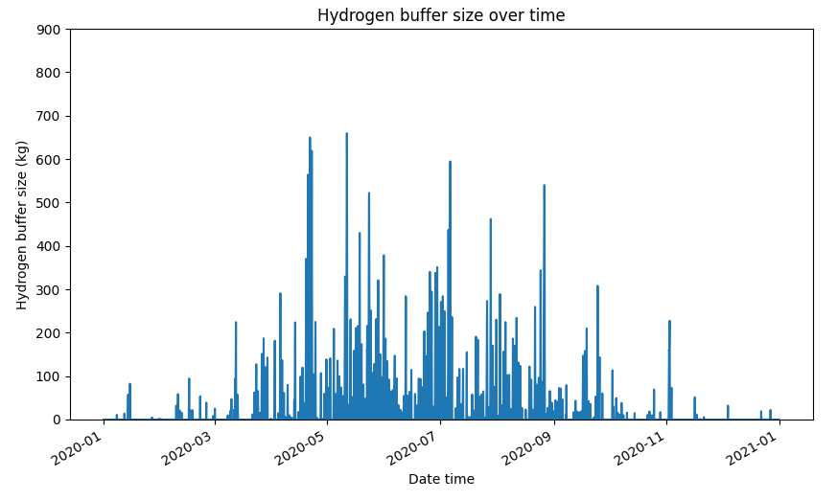
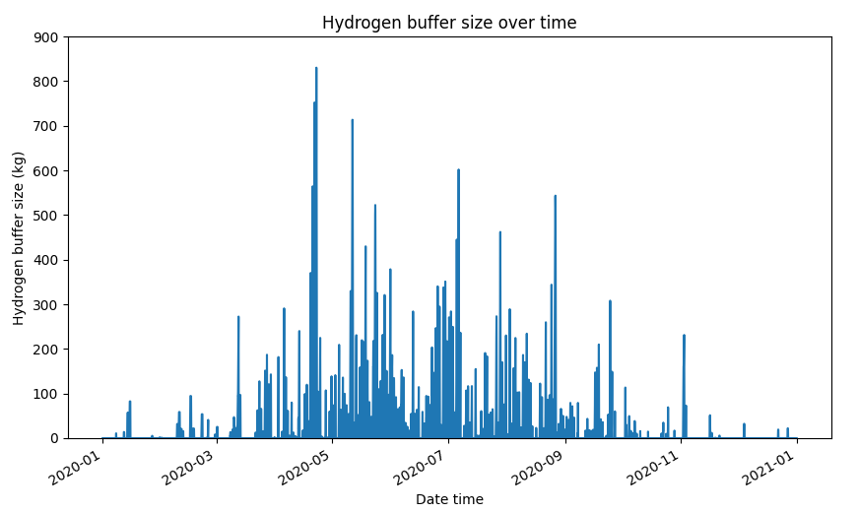

Slide 23
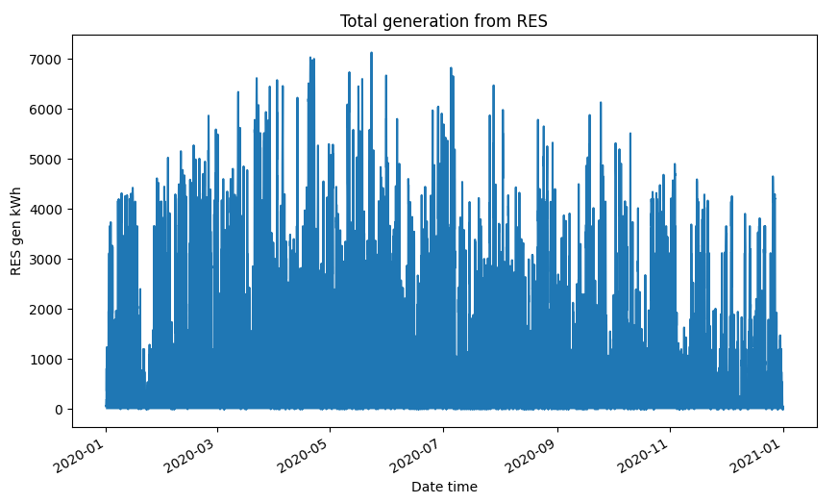

Slide 24
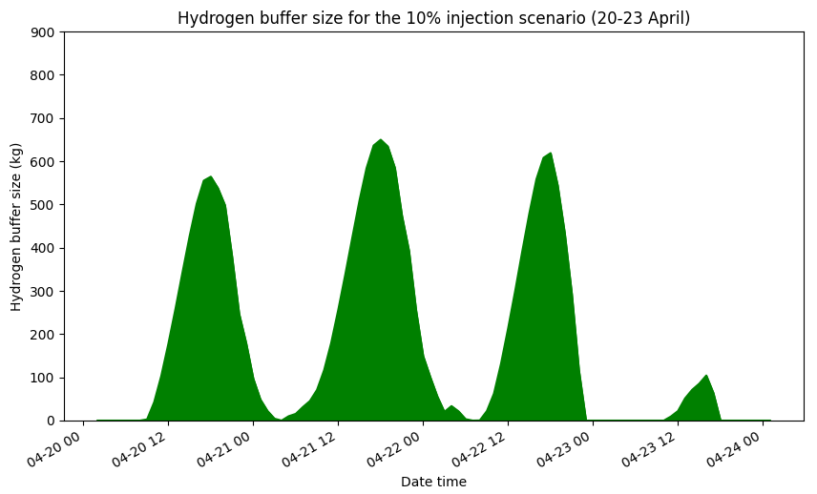
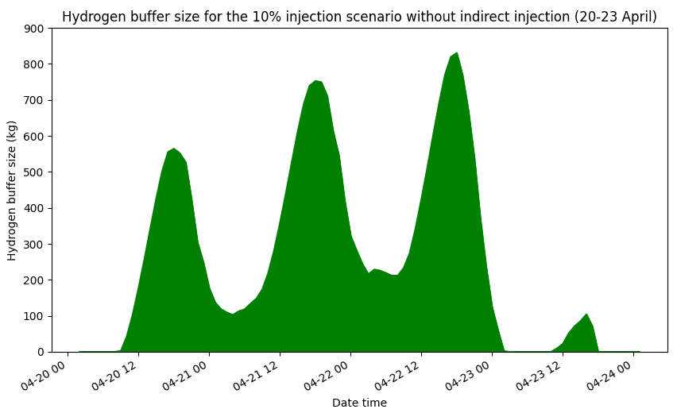

Slide 25
Analyse 2: sensitiviteitsanalyse vereiste opslagcapaciteit
Experiment number | Future injection scenario: | 0% | 3% | 10% | 20%
33 | Base case | 1,395 | 1,149 | 660 | 503
34 | 8.4 MW wind & 4.2 MW PV | 12,532 | 7,597 | 4,927 | 3,789
35 | 12.6 MW wind & 4.2 MW PV | 45,708 | 32,821 | 18,321 | 8,411
36 | 4.2 MW wind & 8.4 MW PV | 2,754 | 2,413 | 1,820 | 1,046
37 | 4.2 MW wind & 12.6 MW PV | 4,406 | 4,060 | 3,263 | 2,252
38 | 250 kWh hourly allowed export | 1,228 | 983 | 598 | 468
39 | 500 kWh hourly allowed export | 1,062 | 817 | 536 | 433
40 | No indirect injection | 1,395 | 1,222 | 830 | 517
Experiment number | Future injection scenario: | 0% | 3% | 10% | 20%
33 | Base case | 0% | -17.63% | -52.69% | -63.94%
34 | 8.4 MW wind & 4.2 MW PV | 0% | -39.38% | -60.68% | -69.77%
35 | 12.6 MW wind & 4.2 MW PV | 0% | -28.19% | -59.92% | -81.60%
36 | 4.2 MW wind & 8.4 MW PV | 0% | -12.38% | -33.91% | -62.02%
37 | 4.2 MW wind & 12.6 MW PV | 0% | -7.85% | -25.94% | -48.89%
38 | 250 kWh hourly allowed export | 0% | -19.95% | -51.30% | -61.89%
39 | 500 kWh hourly allowed export | 0% | -23.07% | -49.53% | -59.23%
40 | No indirect injection | 0% | -12.40% | -40.50% | -62.94%

Slide 27
Discussie
Wanneer verhogen naar 3% maximale injectie?
  Systemen met veel windopwek
  Systemen waarin export is toegestaan
Wanneer verhogen naar 10% maximale injectie?
  Systemen waarin indirecte injectie is toegestaan
Wanneer verhogen naar 20% maximale injectie?
  Systemen gedomineerd door windopwek
  Systemen waarin indirect injectie niet is toegestaan

Slide 28
Limitaties
Model geanalyseerd voor een regionaal energienetwerk
Weerdata van 1 jaar (2020)
Assumptie maximale uurwaarde export hogere voltagenetwerk
Daling prijs waterstofopslag lange termijn

Slide 29
Referenties
Altfeld, K., & Pinchbeck, D. (2013). Admissible hydrogen concentrations in natural gas systems. Gas Energy, 2103(03), 1-2.
Gondal, I. A. (2016). Hydrogen transportation by pipelines. In Compendium of Hydrogen Energy (pp. 301-322). Woodhead Publishing.
Heide, D., Greiner, M., Von Bremen, L., & Hoffmann, C. (2011). Reduced storage and balancing needs in a fully renewable European power system with excess wind and solar power generation. Renewable Energy, 36(9), 2515-2523.
IEA (2015). World Energy Outlook 2015. Retrieved from https://iea.blob.core.windows.net/assets/5a314029-69c2-42a9-98ac-d1c5deeb59b3/WEO2015.pdf
Kroniger, D., & Madlener, R. (2014). Hydrogen storage for wind parks: A real options evaluation for an optimal investment in more flexibility. Applied energy, 136, 931-946.
Mukherjee, U., Elsholkami, M., Walker, S., Fowler, M., Elkamel, A., & Hajimiragha, A. (2015). Optimal sizing of an electrolytic hydrogen production system using an existing natural gas infrastructure. International Journal of Hydrogen Energy, 40(31), 9760-9772.
Qadrdan, M., Abeysekera, M., Chaudry, M., Wu, J., & Jenkins, N. (2015). Role of power-to-gas in an integrated gas and electricity system in Great Britain. International Journal of Hydrogen Energy, 40(17), 5763-5775.
Rodriguez, R. A., Becker, S., Andresen, G. B., Heide, D., & Greiner, M. (2014). Transmission needs across a fully renewable European power system. Renewable Energy, 63, 467-476.
Scamman, D., & Newborough, M. (2016). Using surplus nuclear power for hydrogen mobility and power-to-gas in France. international journal of hydrogen energy, 41(24), 10080-10089.
Schaber, K. (2014). Integration of Variable Renewable Energies in the European power system: a model-based analysis of transmission grid extensions and energy sector coupling (Doctoral dissertation, Technische Universität München, Munich, Germany). Retrieved from https://mediatum.ub.tum.de/doc/1163646/1163646.pdf
Simonis, B., & Newborough, M. (2017). Sizing and operating power-to-gas systems to absorb excess renewable electricity. International journal of hydrogen energy, 42(34), 21635-21647.
Steinke, F., Wolfrum, P., & Hoffmann, C. (2013). Grid vs. storage in a 100% renewable Europe. Renewable Energy, 50, 826-832.

